Slide 1






Slide 2



(Ticket Granting Server)
TGS
krbtgt
ASS
(Authority Service Something)
DB
)Data Base)

Slide 3
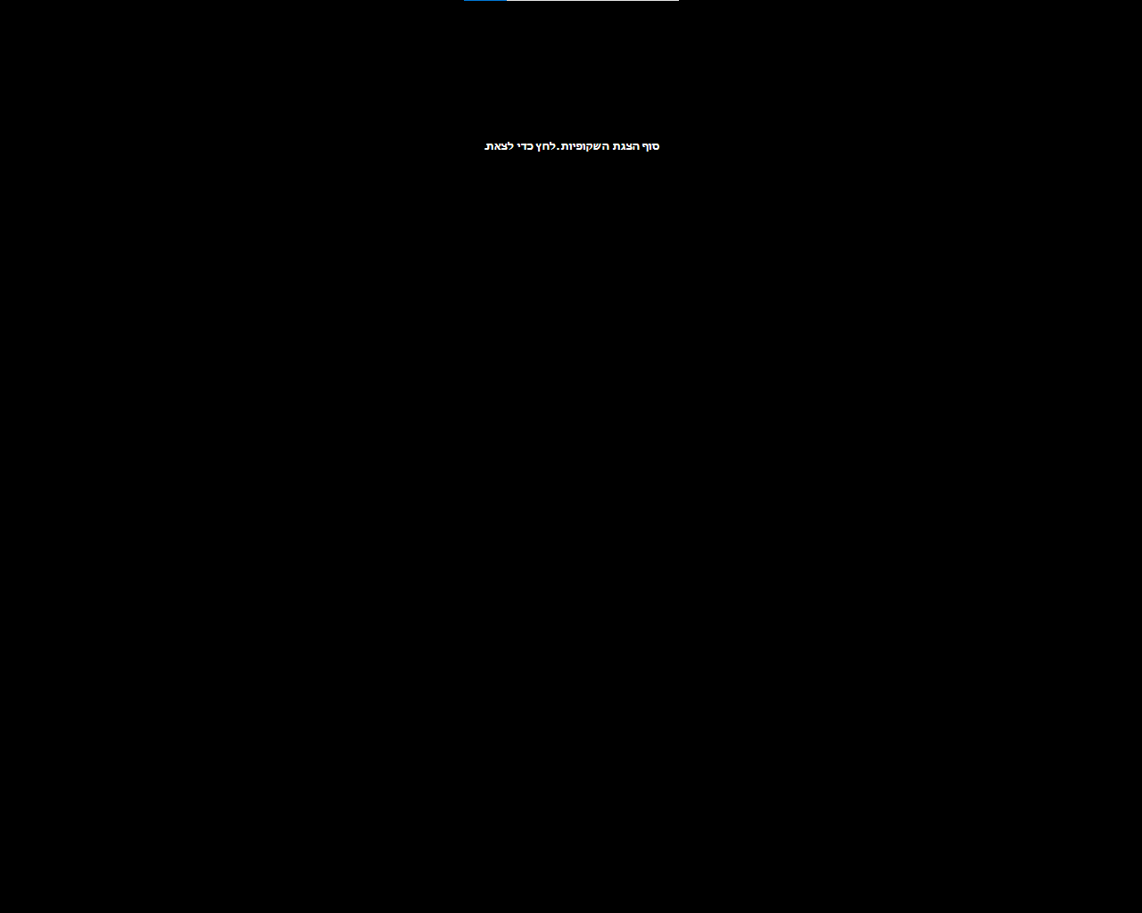

Slide 4









1

Slide 5

Data
2

Slide 6
מידע
3

